Slide 1
Gym Modernization: D II
By Alek, Akram, Daniel, Jay, Tom, PK

Slide 2
Requirements

Slide 3
Functional Requirements:
Process-oriented:
The system must be able to add new users to the system. This is a Process-oriented requirement, as it is required to support a user task.
The system must allow users to set their gym schedules and appointments.
Information-oriented:
The system must allow users to review their gym schedules and appointments. This is a Information-oriented requirement as the system should provide this information as the user performs a task. This is to assist the user in schedule building.
The system must retain customer profiles for 2 years after lapsing membership
The system must record the date and time of every check-in from each user for 3 years.

Slide 4
Non-functional Requirements:
Operational
The system should be cloud-based.
The system’s web interface will use the Responsive Web Design approach.
Performance
Any interaction between the user and the system should not exceed 20 seconds.
Security
System only admits current members
Will utilize 128 bit A5/1 Encryption for payments
Political
Will adhere to all mandatory constraints imposed by Federal Regulation

Slide 5
Interviews

Slide 6
Rex Kwon: Marketing Specialist
The age range of customers is wide for this gym and it’s hard to know who comes when. The marketing director has a website for the gym but it’s very basic and doesn’t allow much interaction for the customers. Marketing is not very efficient with the budget they have but could be improved to attract more clients.
Q: Are you interested in knowing the age ranges of people who are trying to join?
A: Yes! It would help us to improve our equipment and focus group.
Q: How often are people paying?
A: Monthly, or a yearly subscription.
Q: Is your website attractive to potential new customers?
A: I believe it is, however, there needs to be more interactive features such as logins and clickables etc. Also, I do not want our prices on the site, the interactive features and member benefits section is enough and they can click a button for scheduling a visit.
Q: Do you have any particulars regarding the channel in which you market and who you market toward?
A: Yes, as our budget is not large, we have a commercial that airs twice per month. We have the video on file and was hoping we could have add it to the more cost effective internet marketing. We are marketing to all age ranges but want to become more trend forward with the crowds between ages 18 - 40.

Slide 7
Napoleon Bona: Operations Specialist
Operations are very basic at the gym. They have the minimal amount of information regarding their service. Their logging information is an old school style and not very efficient at the moment, making it even more difficult to expand or grow to other locations.
Q: Is your transaction processing system lacking in any way?
A: It is very simple, in store cash or credit system.
Q: Is your website efficient with information?
A: Our website has our location, how to get here, basic equipment list, and our rates.
Q: Is it difficult to check if everyone entering the gym with expired memberships?
A: It is very difficult.
Q: Have you guys looked into the cost of expanding your gym? Another location?
A: The cost and time for opening another gym isn’t too bad right now but the main issue we would face is being able to transfer data from one gym to the other. It’s doable but way too time consuming.

Slide 8
John Smith: Gym Member
Gym members are unable to have a consistent schedule at the gym. A solution for this could be online access to the gyms availability. The system they have at the gym makes it tedious to clock in and out.
Q: How long have you been attending this gym?
A: A couple months
Q: How would you describe your experience with the log-in system?
A: It’s been alright, It’s kind of annoying to see people sneak in all the time when I bring my card all the time though.
Q: We are currently in the process of planning to revamp our system. How do you feel about an easier login and logout system?
A: Of course, that would be much easier and less time-consuming!
Q: How would you describe your gym schedule here? A: Well I try to come every day, but sometimes it’s very busy and I don’t get as good of a workout.
Q: Are you usually aware when the gym is busy?
A: It’s pretty much a gamble. I really wouldn’t know what time is best to come in.

Slide 9
Use Case Documents

Slide 10
Actors
Gym Member
Personal Trainer
Receptionist

Slide 11
UC 1 - Online Interaction
The gym member can log into their online profile for the gym. The gym member can then sign up for fitness classes. The gym member can also book an appointment with a personal trainer.

Slide 12
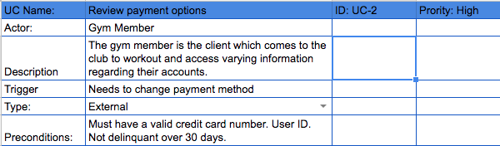
Online Interaction

Slide 13
UC 2 - Member Card Issue
If a gym member has issues with paying for their membership, they can go to the receptionist to resolve the issue.
The major part of the process is to pay for the membership. The gym member can pay using credit card or debit card. The user must provide a valid credit or debit card with a valid security code or PIN.

Slide 14
UC 3 - Check In/Out
This process is used to allow gym members access to the gym. The gym member brings his membership card to the receptionist. If the gym member does not have his/her card, refer to member card issue process.
The receptionist scans the member card. The member card is validated by the systems. If the card and account are valid, the gym member is granted access to the gym. If not, the gym member is denied access to the gym.
This process can also be used by personal trainers for fitness classes.

Slide 15
Use Case Diagrams

Slide 16
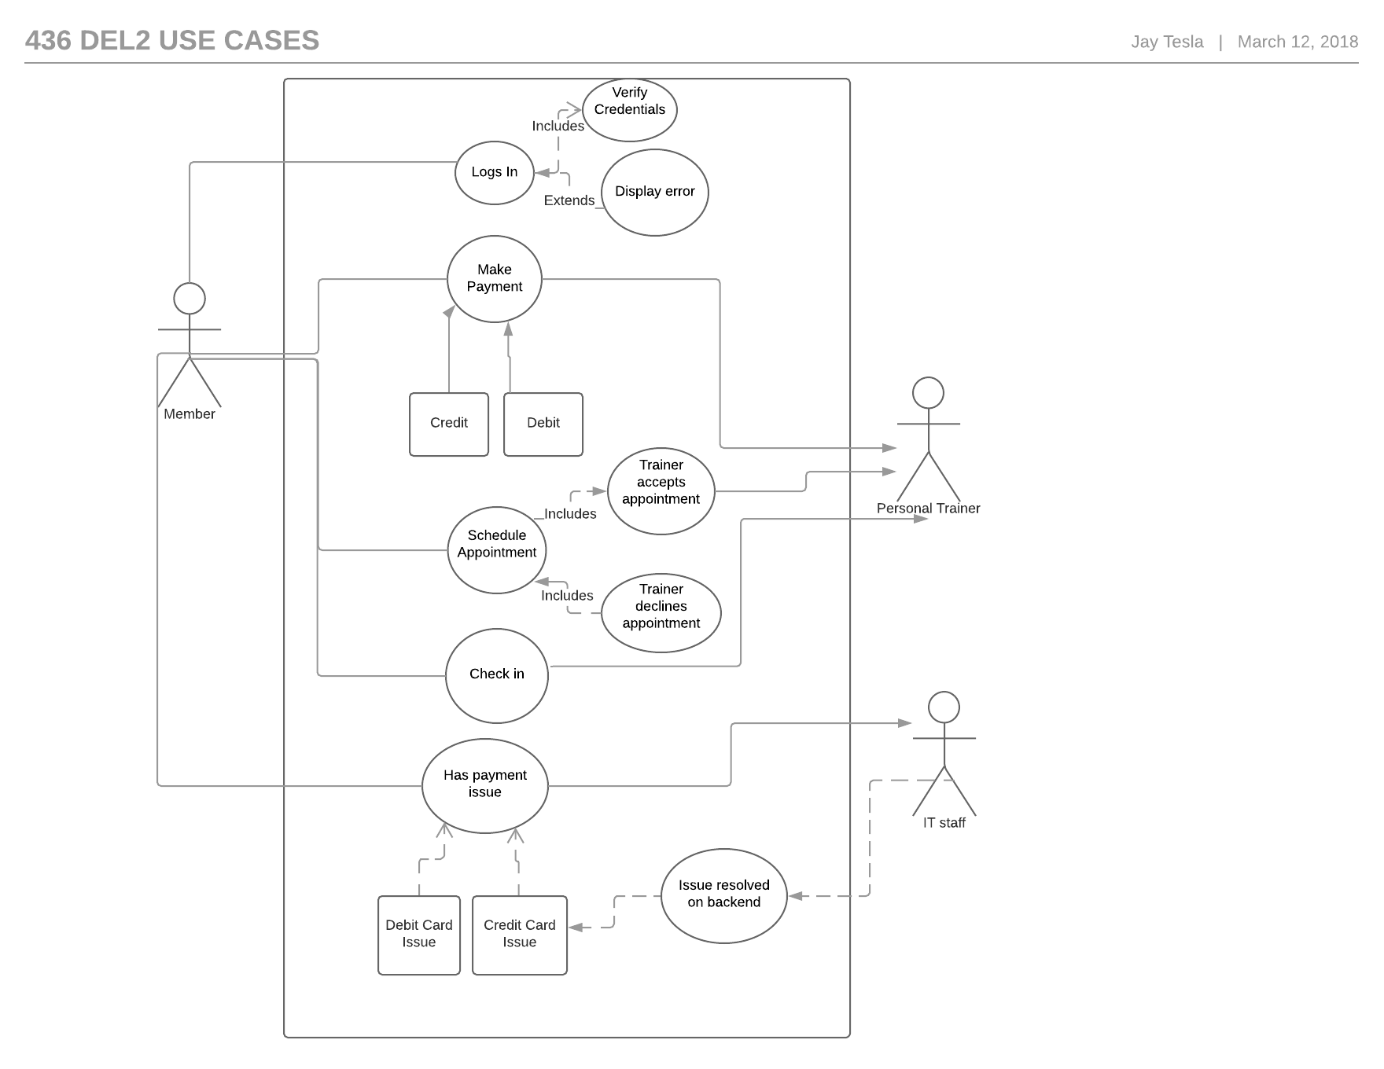
UC Diagram 1 - Online Interaction

Slide 17
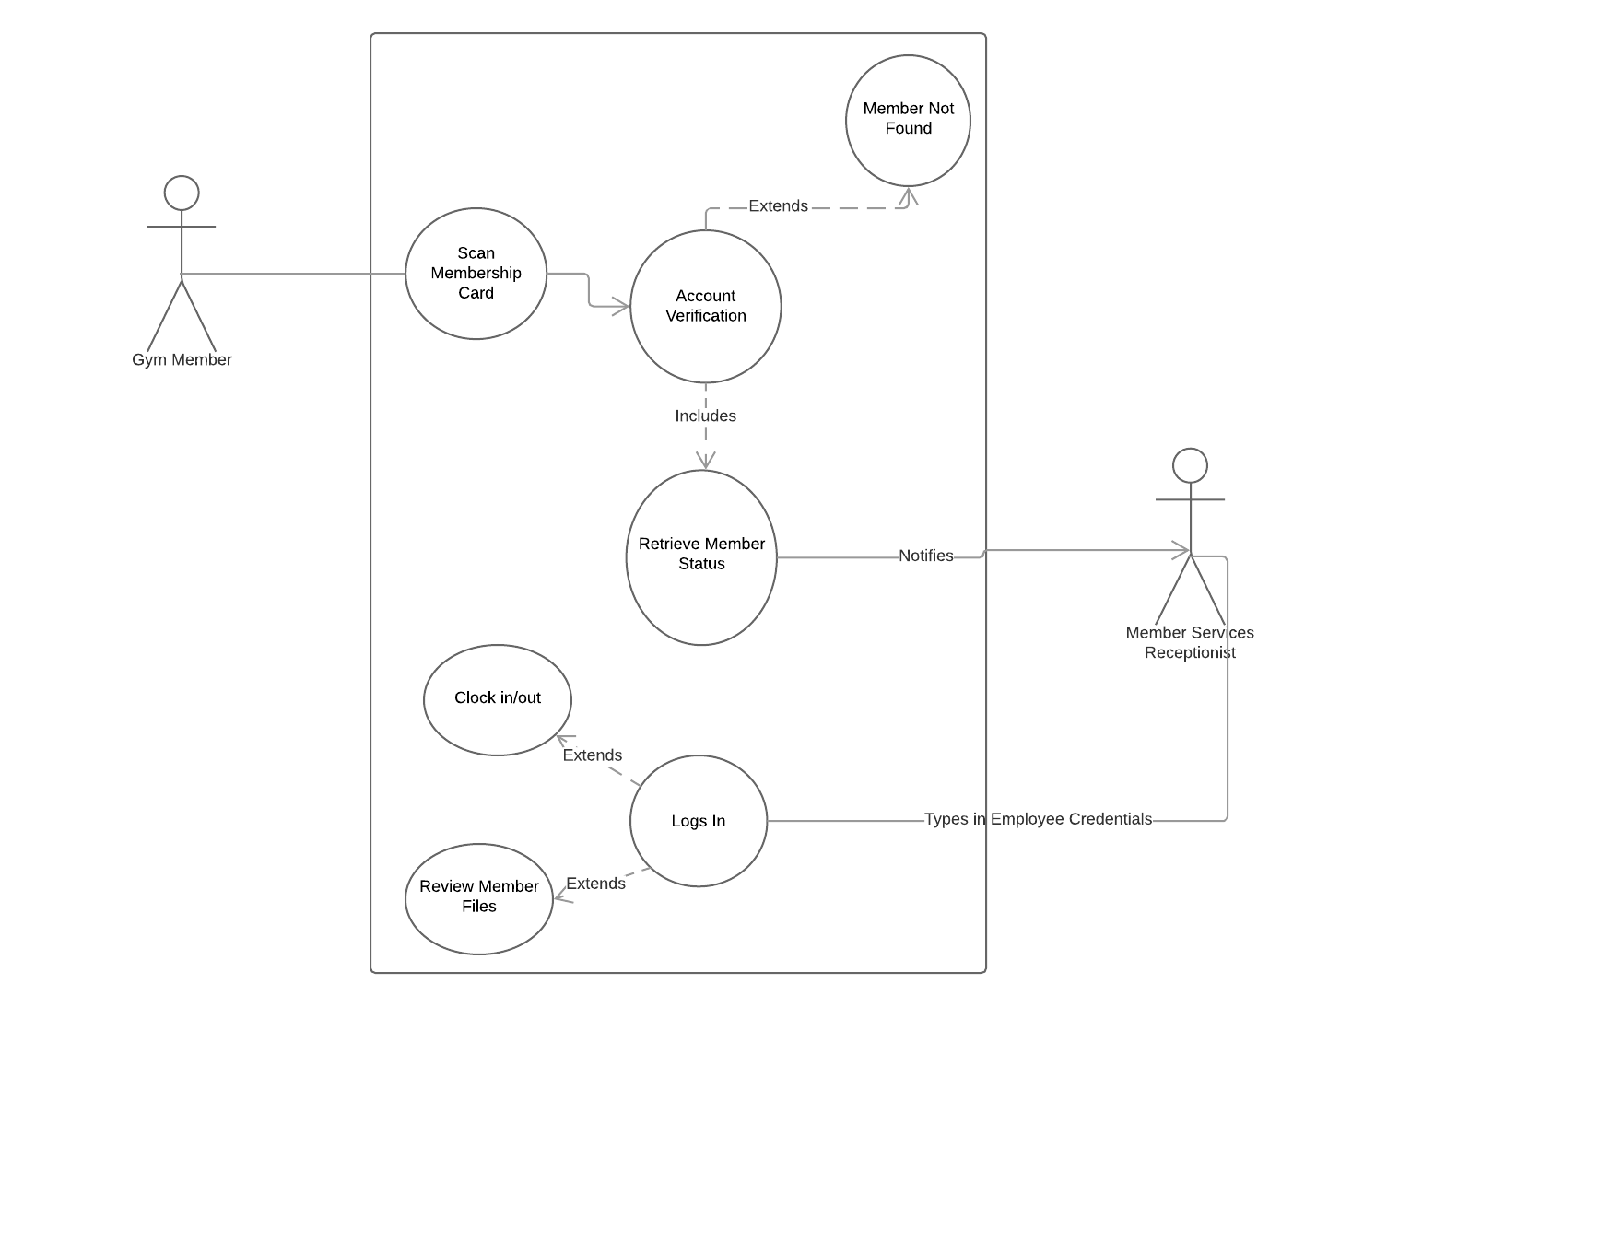
UC Diagram 2 - Member Check in

